Slide 1
IBM CAPSTONE PROJECT The Battle of Neighborhoods:
Best location for new Gym and Fitness center in Riga

Slide 2
Introduction: Business Problem
Nowadays in most cases work requires seating for multiple hours a day, which is very unhealthy for humans. Therefore, various sport venues became more and more popular among student and young workers.
It is quite nice choice for new business but where will be better choice to start?

Slide 3
Introduction: Goal and Target audience
Goal: Our goal to building a recommendation system for finding best suitable Gym/Fitness Center for “active-age” population (young people from 15- 49) based on certain criteria.
Target Audience: Group of activists and investors who want to start “gym/fitness business” in Riga.

Slide 4
Data
Riga City Neighborhood & Population.
Data source: Central Statistical Bureau of Latvia
http://data1.csb.gov.lv/pxweb/en/iedz/iedz__tautassk__riga__tsk2011/TSG11-R02.px/?rxid=0cebbc5d-dfba-43d1-903e-e18eb1de0eaf
GeoJSON file for Riga’s Neighborhoods.
Data source: https://github.com/art-licis/riga-geojson-neighbourhoods
Gyms/Fitness Center in each neighborhood of Riga.
Data source: Foursquare API

Slide 5
Methodology
We begin by collecting the Riga city data from Central Statistical Bureau of Latvia
We analyse population of Riga by Neighborhoods ( total and at age 15-49)
We find all venues for each neighbourhood using Foursquare API.
We analyse population of Riga by Neighborhoods ( total and at age 15-49)
We used the Elbow Point to chose the best K value for K-Means clustering.
We clustering the neighbourhoods based on the neighbourhoods that had similar average of Gyms in that Neighborhood .
We join this dataset to original Riga data to get longitude and latitude.
Finally, we visualize the Neighbourhoods and Clusters based on average of of Gyms / Fitness Center and population ( age 15-49) in each Neighborhood using python’s Folium library.

Slide 6
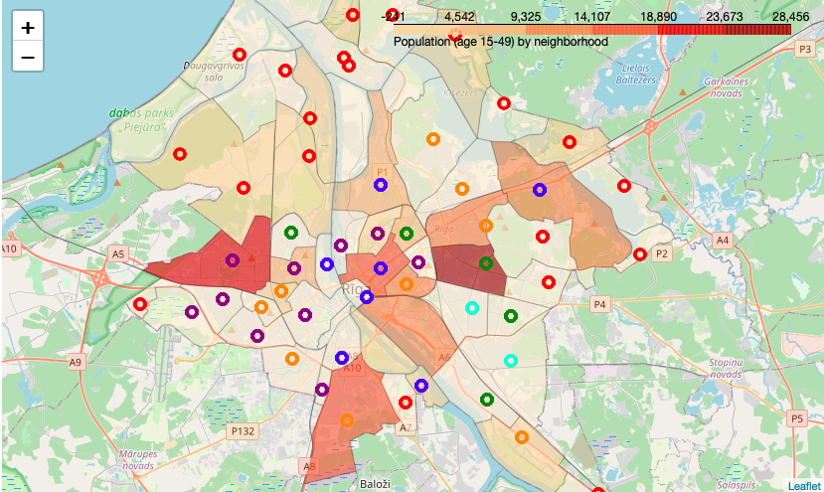

Slide 7
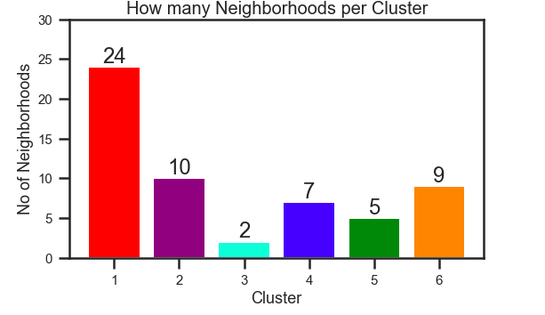
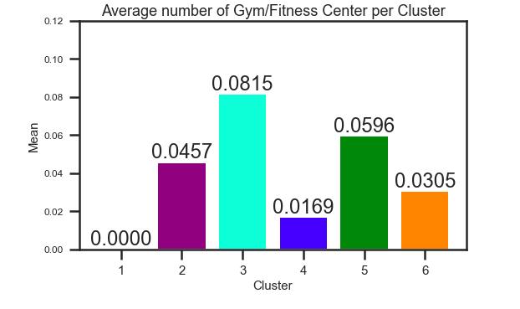
Results
Even though there is only 2 neighbourhood in Cluster 3, it has the highest number of Gym/Fitness Center (0.08) while Cluster 1 has the most neighbourhoods but has the least average of Gym/Fitness Center = zero (0.0000).
We see that Cluster 3 has the least neighbourhoods (2) while Cluster 1 has the most (24). Cluster 2 has 10 neighbourhoods, Cluster 6 has 9, Cluster 4 has 7 and Cluster 5 has only 5.

Slide 8
Cluster 1 –There was a most of neighbourhoods (24), 362 different venues and NO Gym/Fitness Center at all. May be because of Neighborhoods in Cluster 1 are the most sparsely populated in Riga, mainly located in Riga suburb, far from historical and office center.
Cluster 2 -Second place by Neighborhood count (10) and 543 different venues. It also has most Gym/Fitness centers - 38. But the average amount of Gym/Fitness Centers that were 0.0457. In the map, we can see that neighborhoods of Cluster 2 also sparsely populated clusters (except Imanta – third most populated Neighborhood in Riga).
Cluster 3 - located in the east of Riga .There was a total of 103 unique venues and out of those 11 were Gym / Fitness Centers. It has the highest average of Gym / Fitness Centers (0.0815). The reason why the AVERAGE of Gym / Fitness Centers is the highest is that all these Gyms are in two neighbourhoods, Darzciems and Skirotava.
Cluster 4 - mainly located in the historical & office center of Riga . There were a total of 477 unique Venues in Cluster 4 with 10 Gym/Fitness Center. But the average of Gym / Fitness Centers was rather low - 0.0169.
Cluster 5 - mainly residential sleeping areas. . 316 unique venues and 22 Gym/Fitness Center. There are 5 rather populated Neighborhoods including Purvciems (most populated Neighborhood in Riga ) .Therefore second-highest average of Gym/ Fitness Centers in that cluster which was approximately 0.0596.
Cluster 6- located in not very expensive but extremely developing areas. Teika, Avoti, Ciekurkalns (in general 9 neighborhood per this cluster) there are many new office centers and young potential customers. Cluster 6 has 503 different venues and 22 Gym/Fitness Center. Average of Gyms 0.0305.

Slide 9
Conclusion
Looking at the nearby venues, the optimum place to put a new Gym/Fitness Center in Cluster 4 as there are many news offices but little to no Gym/Fitness Center, therefore, eliminating any competition.
The second-best Neighborhoods that have a great opportunity would be in areas such as Maskavas forstate. There is no Gym/Fitness Center at all, but it is rather populated and neighborhoods with many young people (potential clients) such as Avoti or Center are not far away.
Having 24 neighbourhoods in the area with no Gym/Fitness Center gives a good opportunity for opening a new one.

